Slide 1
Distributed Network Programming
Prativa Nyaupane

Slide 2
Review
TCP
UDP
IP Address

Slide 3
Outline
TCP
UDP
IP Address
Ports
Socket Programming using TCP and UDP
Working with URLs and URL Connection Class
Email Handling using Java Mail API
Architecture of RMI
Creating and Executing RMI applications
Architecture of CORBA
RMI vs CORBA
IDL and Simple CORBA Program

Slide 4
Ports
In the context of network programming, port number is a communication endpoint used by applications to establish connections and exchange data over a network.
Different types of data flow to and from the computer over the same network connection.
The role of port in a computer network is to identify the type of traffic from the network.
For example, the emails sent or received on a device use a different port than a website accessed through browsers, even when the internet connection in use is the same.

Slide 5
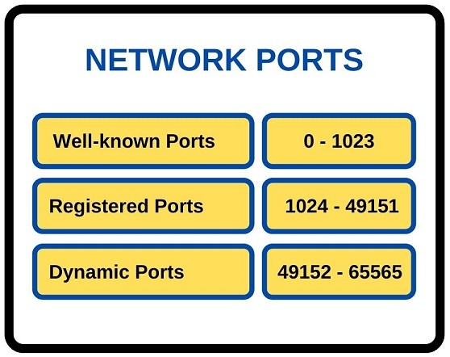
Classification of port numbers:
Ports are identified by numbers, known as port number, which range from 0 to 65535.
The port numbers are divided into three categories:
Well-known Ports
Registered Ports
Dynamic Ports

Slide 6
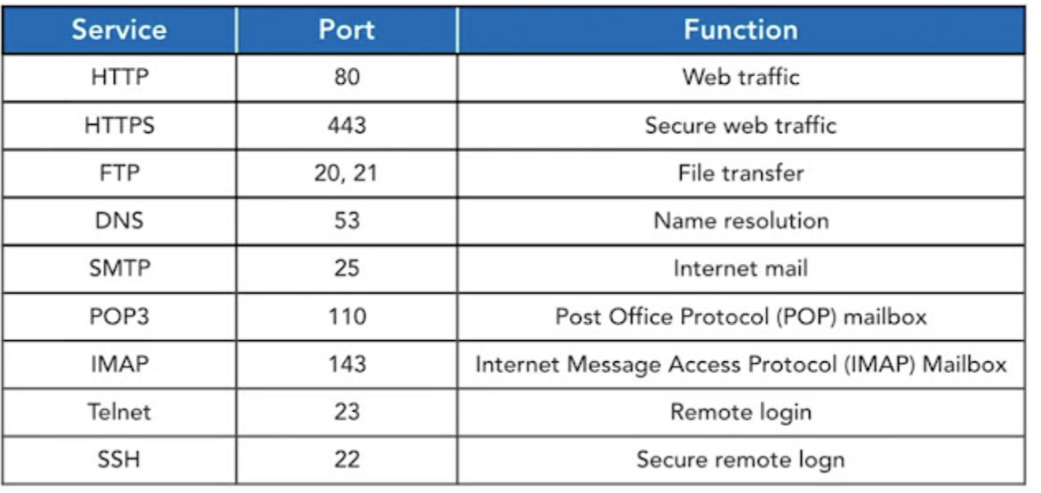
Well-Known Ports
Port numbers from 0 to 1023 are reserved for common TCP/IP applications and are known as well-known ports.
These ports are assigned and controlled by Internet Assigned Numbers Authority(IANA)
Well-known ports are designated for specific services and protocols to ensure standardization and interoperability everywhere.

Slide 7
Registered Ports
The range of registered port is 1024 to 49151.
These ports are registered with IANA but, can be used by applications and services based on their specific requirements.
The registered ports are used for the user processes(programs or applications that are initiated by users).
They are not as standardized as well-known ports, it can be used by various applications and services.
Port 3389: Assigned to Remote Desktop Protocol (RDP), used for remote desktop connections.
Port 5432: Assigned to PostgreSQL database system.
Port 8080: Often used as an alternative HTTP port, commonly used for web proxies and caching servers.

Slide 8
Dynamic Ports
Port numbers from 49512 to 65535 are dynamic or private ports, which can be used by applications for temporary or private purposes.
These port numbers are used by clients applications to initiate communication with servers.
Well-known and registered ports are fixed and assigned to specific services but dynamic ports are temporary.
They are typically allocated dynamically by the operating system from a predefined range.

Slide 9
How is Port used in Computer Network?
When a client wants to establish a connection to a server, it needs to specify the Server’s IP address and the port number to which it wants to connect.
The server listens on a specific port for incoming connections. Once a connection request arrives on the port, the server accepts the connection and establishes communication with the client.
Each network protocol, such as TCP and UDP, has its own set of port numbers.
For eg: TCP and UDP both use port numbers to identify specific processes or services running on a device.

Slide 10
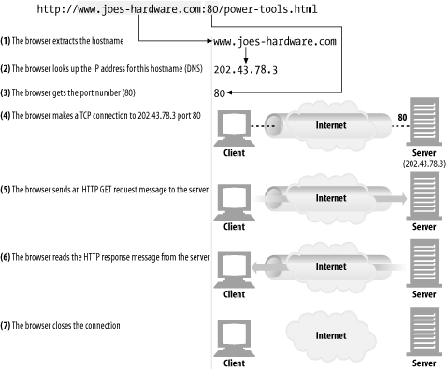

Slide 11
Ports Contd..
Port numbers provide a way for multiple applications or services to coexist on the same device without conflicts. Each application can use a unique port number for its communication needs.
In Java, the ServerSocket class is used to bind a server-side socket to a specific port, allowing the server to listen for incoming connections on that port.

